Slide 1
CS 7470 Project Demo:
SmartPosture
Group 28
Breejesh, Domnica, Japheth, Neel

Slide 2
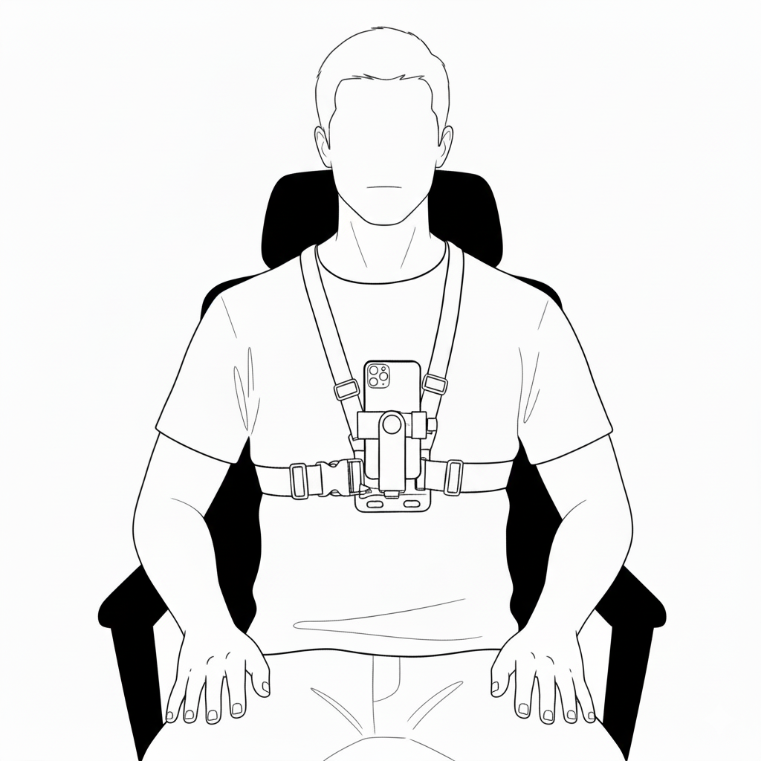
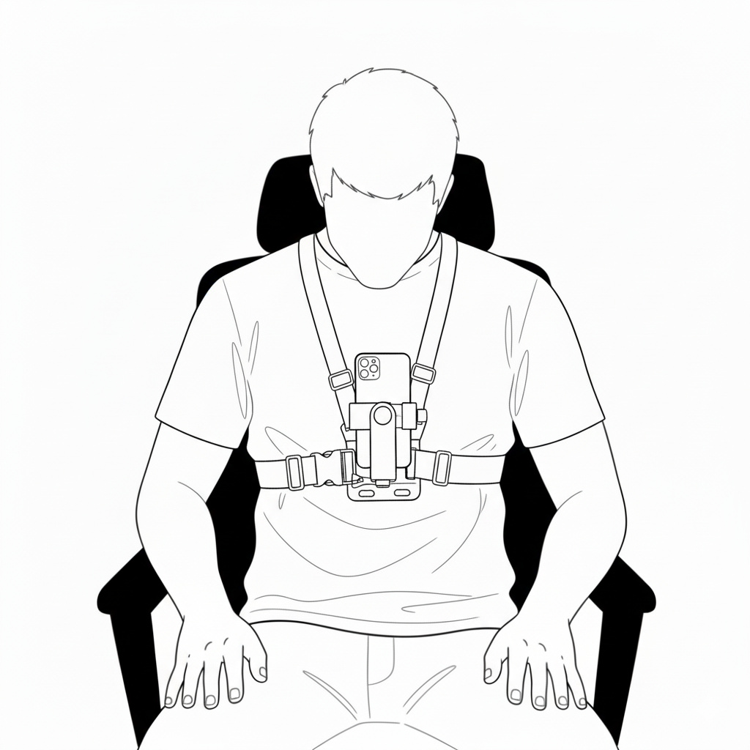
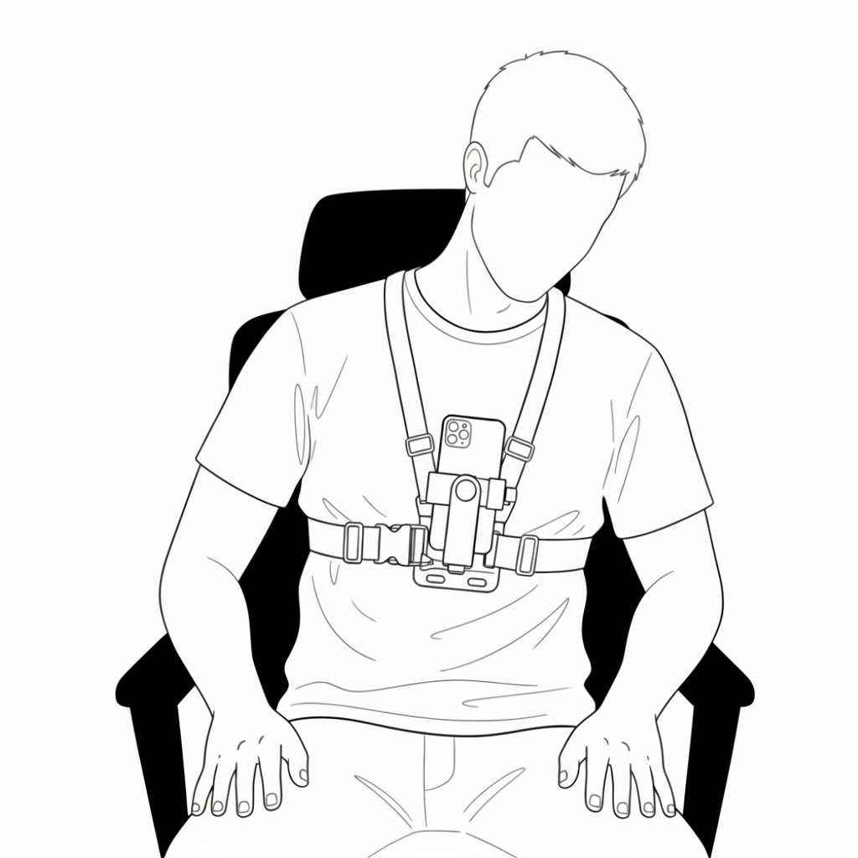
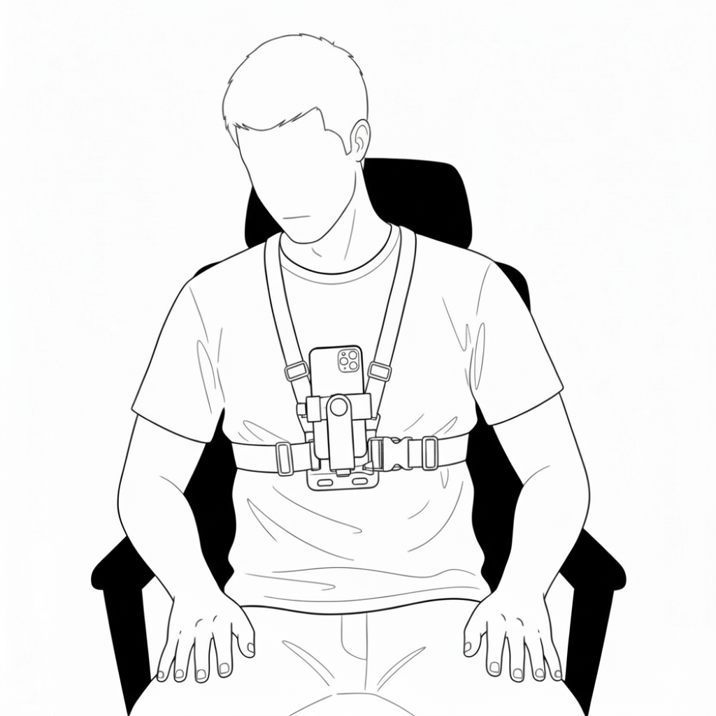
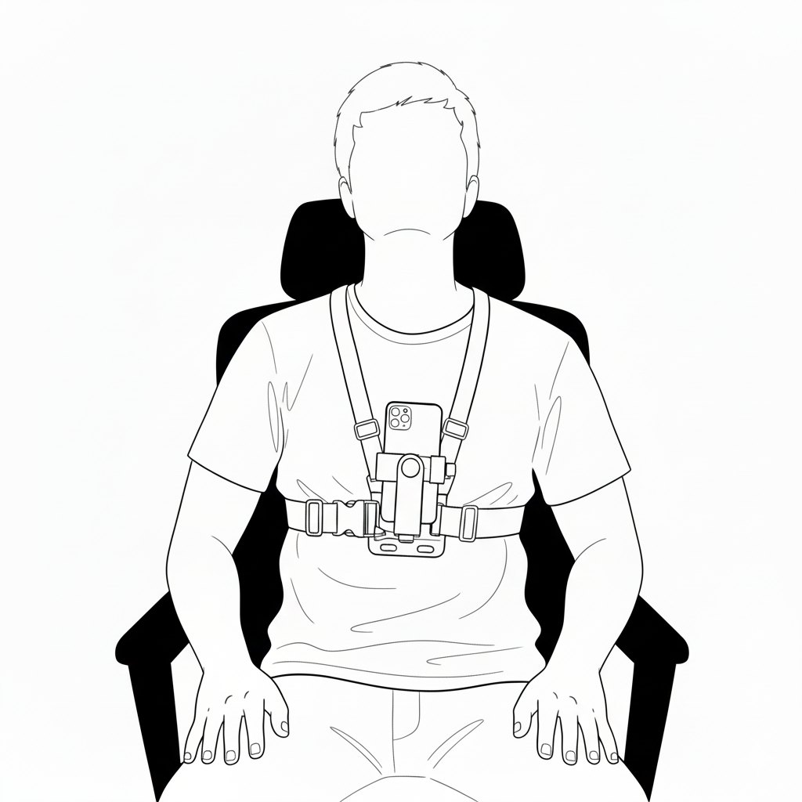
Project Idea and Motivation
Many people sit with poor posture, leading to discomfort and long-term health issues.
Existing solutions often require dedicated hardware such as wearables or smart chairs.
Our goal was to use only the smartphone and easily available and affordable mount to provide simple, accessible and reliable posture awareness.

Slide 3
Aims and Objectives
1
2
3
4
Detect common sitting postures using smartphone sensors
Collect user data using a chest-mounted smartphone
Build ML pipeline for preprocessing, feature extraction, and model training
Develop an Android app that provides real-time posture feedback

Slide 4
What we built
Changes vs original plan
An end-to-end ML System that captures IMU data, extracts features, and classifies posture.
A Random Forest Model exported to ONNX for mobile deployment.
An Android App that runs real-time on-device inference and shows clear session summaries.
We added the gravity sensor, which improved orientation stability and posture detection.
We expanded to five posture classes for better real-world coverage.
We moved to a feature-based Random Forest, which is faster and accurate for real-time use.
We introduced PCA to help with dimensionality reduction

Slide 5
Data collection and Machine learning model
Data collection
Data preprocessing
Feature engineering
ML model
Used a smartphone chest-mount
Recorded accelerometer, gyroscope, gravity, attitude
Each team mate collected data samples for each posture
Trimed beginning/end data
Bucketed data in 0.1s intervals
Scaled all values to the same range (0 to 1)
Computed magnitudes for accel / gyro / grav
Computed PCA for accel / gyro / grav
Used Pitch & yaw from orientation sensor
Extracted mean and sd for each feature selected
Used sliding window method for rolling means
Trained a Random Forest (300 trees and max depth 10)
Achieved ~99% cross-validation accuracy
Classified 5 postures: straight, slouching, lean left/right/back

Slide 6
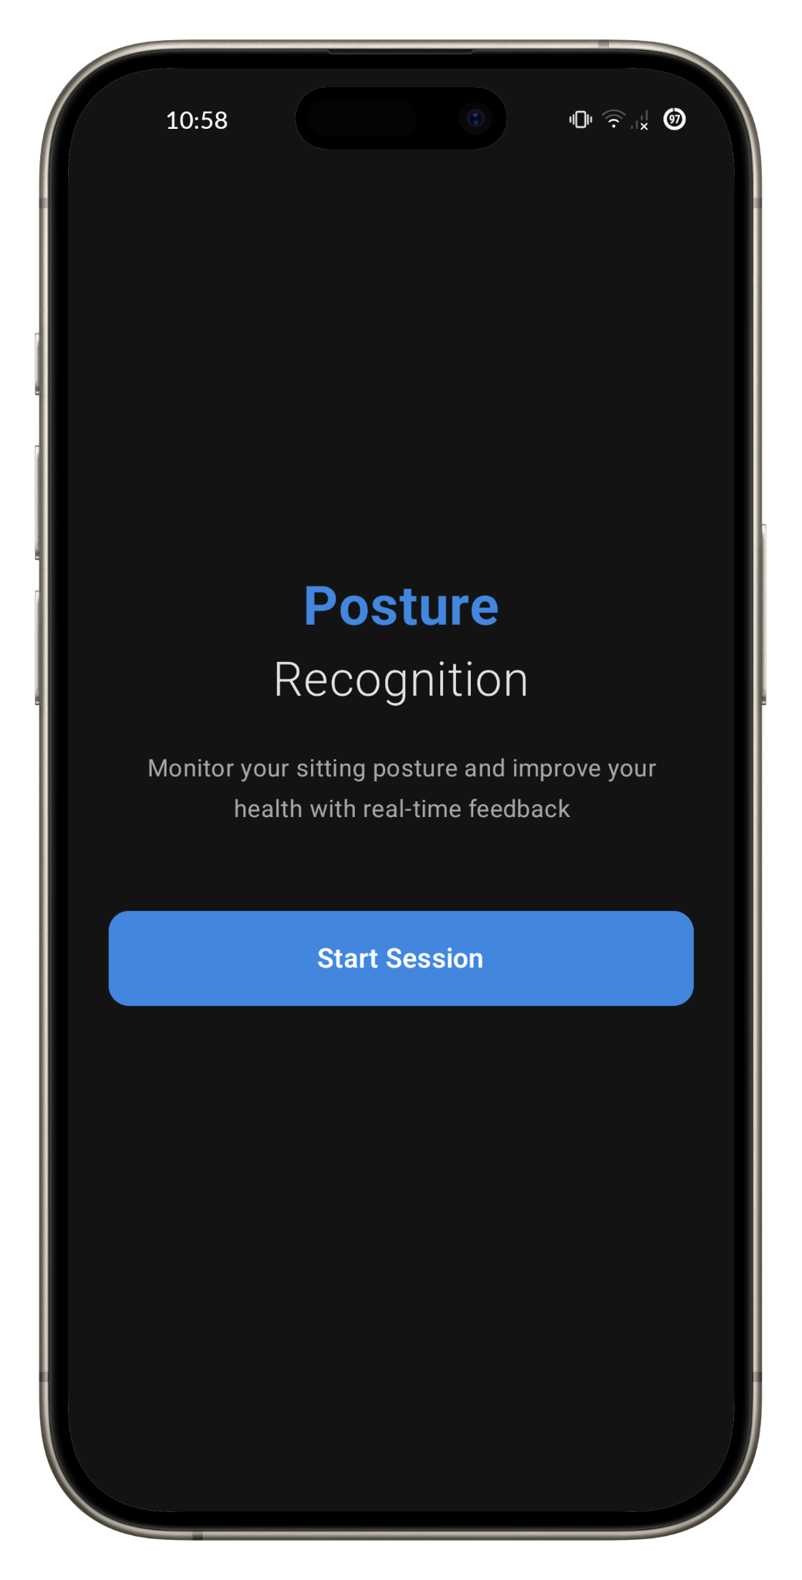
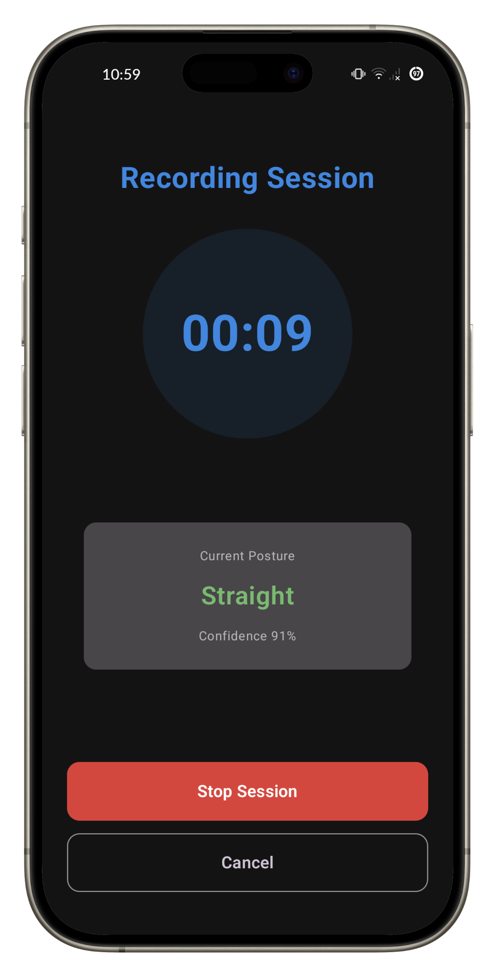
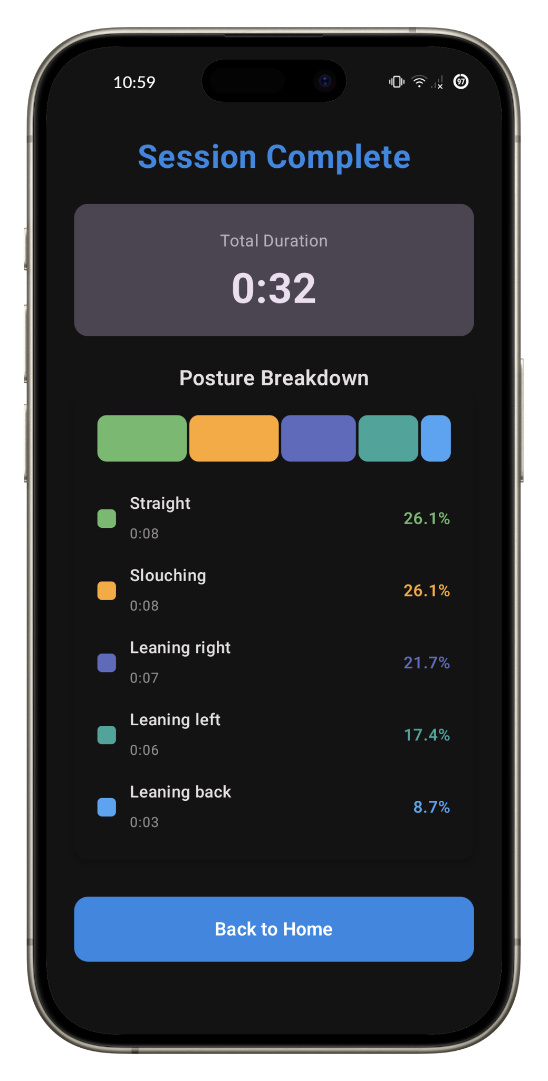
Android Application
Home Screen
Live Screen
Results Screen

Slide 7
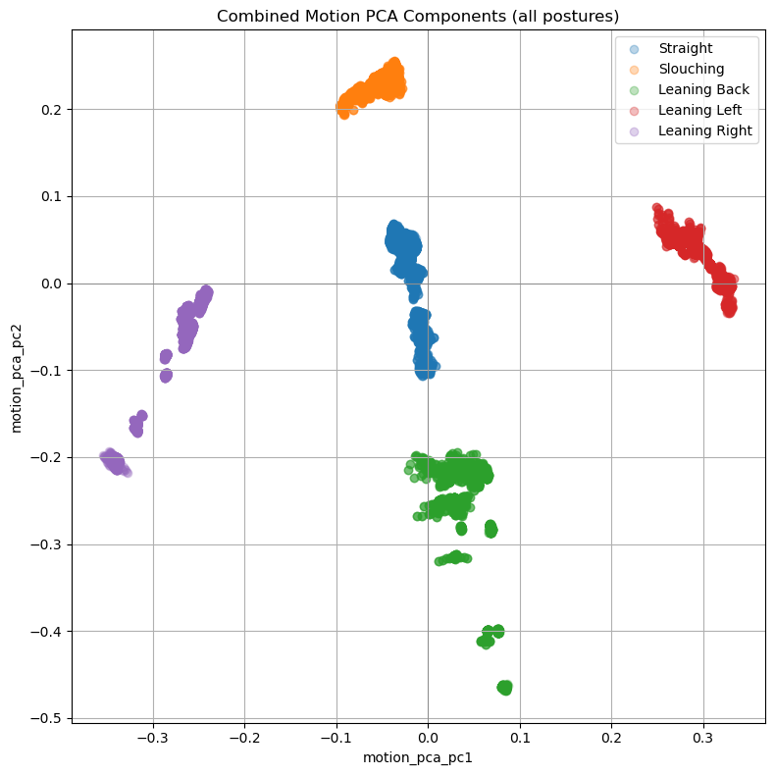
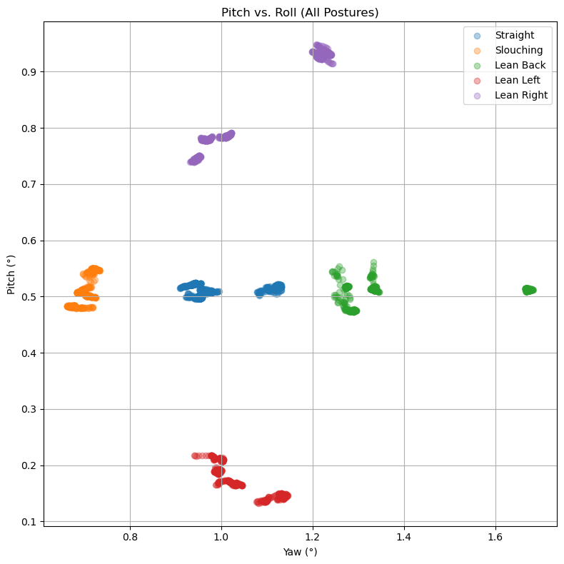
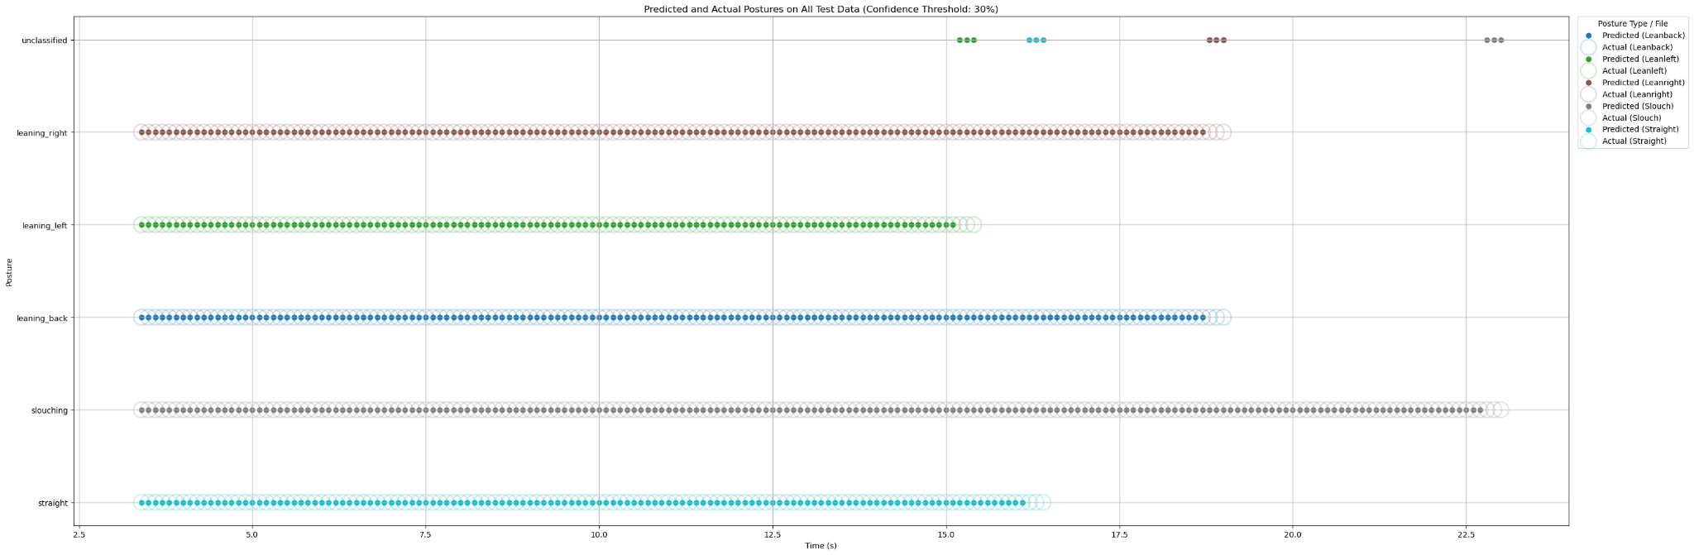
Key Results
Scatter Plot of PCA1 and PCA2 components for each posture showing clean separation
Scatter Plot of Pitch and Yaw sensor values for each posture showing good separation
Plotting Test Results for the Model, Predicted vs Actual Posture for Test Data Set

Slide 8
Reflection, limitations and future work
Reflection
We built a complete pipeline from sensing to mobile deployment.
Preprocessing and sensor choice had the largest impact on performance.
The chest-mounted placement produced clean, reliable data.
The project strengthened our understanding of ubiquitous sensing and on-device ML.
Limitations & Future Work
The dataset was small and collected under controlled conditions.
More participants and varied environments would improve generalization.
Future additions include real-time alerts, more postures, and personalized calibration.

Slide 9
App demo

Slide 10
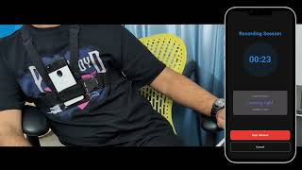

Slide 11
Thank You
Group 28
Breejesh, Domnica, Japheth, Neel

Slide 12
Testing, evaluation and results
Testing & Evaluation
Evaluated using held-out recordings processed through the same pipeline.
Model predictions closely matched the ground-truth labels.
Very few low-confidence windows were marked as unclassified.
Strong performance for all five posture categories.
Key Results
High accuracy and stable performance across sessions.
PCA significantly improved classification consistency.
Android inference was smooth and responsive in real time.

